Slide 1


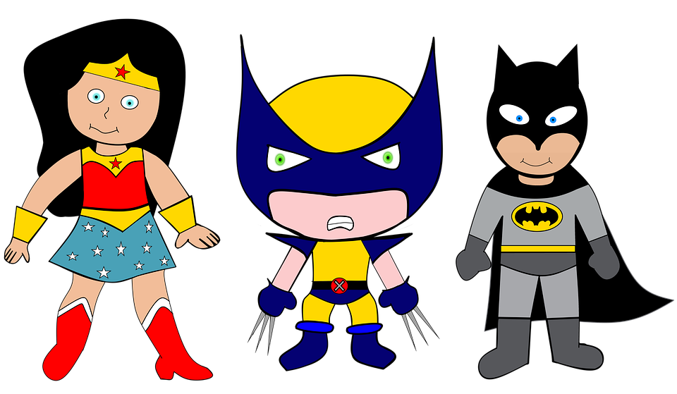

We are SUPERheroes!
Students Using their Powers to Engage in Reading!
Kindergarten Newsletter – December 13-17, 2021
IMPORTANT EVENTS
Breakfast ends at 7:25!
12-13 12-14 12-15 12-16 12-17 | Grinch day (dress up) Tacky Sweater day (dress up) Christmas Tree day (dress up) North Pole day (dress up) Movie & Pajama day
The EXPERT in anything was once a BEGINNER!
HOMEWORK
Mon. – Thurs. | Weekly ELA Sheet Math HW Pages Practice Sight Words List Read 10 minutes per night
WEEKLY ASSESSMENTS
ELA | Module 4.4 test Spelling Test (fan, bam, cap, map, sat) Study All PrePrimer Sight Words and Uppercase/Lowercase Letters Initial Sounds test
Math
SCHOOL NEWS
Send $1 for custodians Christmas Parties on Dec. 20th (no parents please) December 21 is a 60% day. Winter Break is: December 22- January 7 Have a great break!
WEEKLY MATH SKILLS
2D shapes/Positional words Writing 1,2,3,4,5,6,7,8,9,10 More and Less Decompose numbers 3-10 Adding/subtracting
REMINDERS
Please make sure all money is sent in your child’s blue folder labeled and sealed. If your child is absent, please send an excuse labeled with the following information: Child’s name, date of absence, teacher’s name, and reason for absence.
SCHOOL SAFETY
Be sure your child wears a mask to school DAILY!

Slide 2
Module 4 Week 4: Happy Healthy Me!
LEARNING MINDSET: Setting Goals
ESSENTIAL QUESTION
How can I be my healthiest self?
PHONICS
Introduce Letters: Jj and Ww - og word family
READING
Genre: Fiction Story Elements: Characters, Settings, Events Informational Texts | Listening Comprehension Parts of a Book Collaborative discussions
WORDS TO KNOW
Had Be Do Ten
VOCABULARY
BIG IDEA WORDS: energy, exercise, healthy POWER WORDS: peaceful, relax, and rest Books: Getting Rest and Poem Bed
REVIEW
Letters and sounds Aa-Ff Gg-Pp Qq-Zz
WRITING
Nouns and Verbs Characters/Setting Narratives
SPELLING WORDS
Fan Bam Cap Map Sat
PHONEMIC AWARENESS
Identify Rhymes Identify Syllables Beg., Medial, Final Sounds

